Slide 1


Cristiano Cannarsa
Chairman and Chief Executive Officer Sogei S.p.A.
versione 11 dicembre 2013
Innovation, Quality and Improvement of Registry Services
Presidenza Italiana del Comitato Permanente del Catasto nell’U.E.
Conferenza e Riunione Plenaria
Roma, 20 – 21 novembre 2014
Ministero degli Affari Esteri - Sala Conferenze Internazionali

Slide 2

Sogei S.p.A.
With more than 35 years of experience in the ICT sector of the Ministry of Economy and Finance (MEF), Sogei has designed and implemented the Tax Registry and helped automate the Tax Administration’s core services. Since July 2013, with the incorporation of the IT department of CONSIP SpA (the Procurement Company of the PA) , Sogei has become "The Technological Partner" of MEF
State owned company
(IRI STET)
Private stock company
State owned company
(100% MEF)
WEB technology for the community
The Tax Registry automation
Incorporation of Consip IT Dept.
1982
1991
2002
2013
1976
1981
1992
2001
SOGEI is
established
Financial Administration modernization
The e-government Era
1985/1986
2003/2004
2007/2008
2011
Focus
Land division
From VAX to Windows/Unix
Division Cadaster and Cartography System
Distributed system
VAX architecture System
Distributed system
From distributed to centralised Real Estate registry
Virtualisation of the land registry system… from 103 to 9 servers
2

Slide 3



Figures
2.167
41 million €
510 million
Employees 60% with university degree (total 2,167 as of dec. 2013)
The technology investment for 2014 (35 million € in 2013)
The value of production estimated for 2014
(447 million € in 2013)
MEF
Clients
PA
Information System Finance (SIF)
Information System Economy (SIE)
Special Projects
  Revenue Agency
  Customs and State Monopolies Agency
  State Property Agency
  Department of Finance
  Equitalia
  MEF School for the Economy and Finance
  The State General Accounting Office (for health projects)
  UDC – Offices of direct collaboration with the Minister within MEF
  GDF – Italian Finance Police
  DAG – Department for the Administration, Personnel and Services of the MEF
  DT – Treasury Department
  RGS – State General Accounting Office
  UDC – Offices of direct collaboration with the Minister within the Economy Department
  Court of Audits
  Ministry of Interior (National Resident Population Registry,
  Unified Digital Identification Document)
  Ministry of Economic Development (Economic Cohesion Department)
  Presidency of the Council of Ministers (DIPE)
  AgID (Agency for Digital Italy)
3

Slide 4




Services
Applications
Infrastructure
Development and maintenance of software applications for the operational and management processes of MEF
Managing Data Center and peripheral and central infrastructure
+ 1.000
82.000
2.000
3
Application kits that guarantee the functioning of the operational and management processes for 2.000 offices (MEF)
Focus
Land Division
Work stations
Offices
Data Centers
Focus
Land Division
Application kits | Number*
Cadastre | 76
Land registry | 47
Real estate market observatory | 11
Areas | WS | Offices
Cadastre |  | 138
Land registry |  | 103
Total | 12.000 | 241
(*) 134 applications kits equivalent to 78k Function Points
4

Slide 5






Key figures databases
4 Bln
Public Gaming Transactions
41 Mln
Gaming
Real Estate Owners
8,5 Mln
Gaming accounts
88 Mln
Cadastral surveys
Land Reg. Ag.
71 Mln
Urban real estate properties
170 Mln
Database
Revenue services
F24 Tax payments
24 Mln
Land Owners
90 Mln
Documents submitted for income statements
1,6 Mln
Monthly Payslips
Finance
Public Accounting, HR
Healthcare
Customs
50.000
Final Balance Sheets
14.000
800.000
800 Mln
42 Mln
Investment
projects
Programme
projects
Prescriptions
Customs transaction files
5

Slide 6
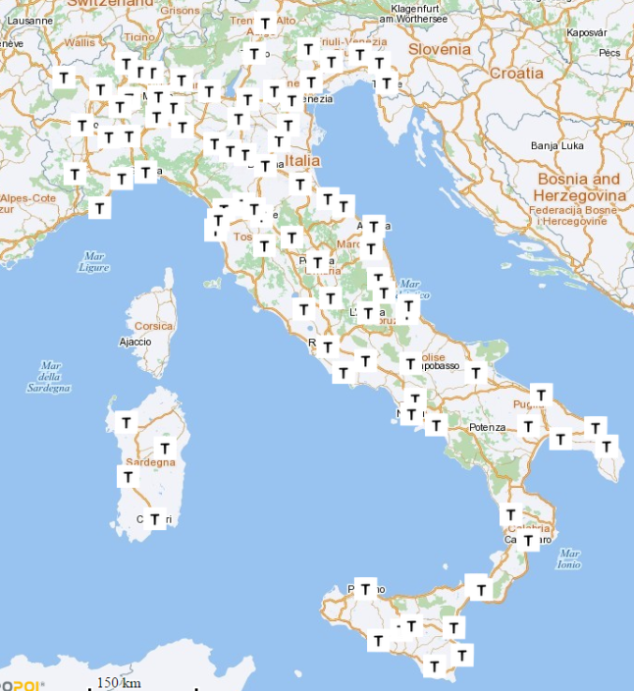
Revenue Agency – Land Division offices
6

Slide 7



Revenue Agency - Land Division - Services and Users
Users
Operational Areas
Citizens
LAND AGENCY
                Require mainly services of Cadastral Survey and certification of cadastral information
Cadaster
and
Real estate registry
Real estate
cartography
market
observatory
Professionals
Land
Buildings
Registrations
Real estate
register
                Use the services mainly to access and obtain cadastral information and to prepare and submit updated documents, also electronically
Includes
the
inventory
of
real
Manages real estate registry. Where properties transfer deeds and mortgages are registred
Collects
information
on
estate
properties
value
of
.
Defines
the
the
real
estate
market
purposes
properties
for
tax
and
analyzes
its
changes
over
time
Administrations
                Are central and local Public Administrations, as well as public and private entities, using the services for analysis and control activities
7

Slide 8


Revenue Agency– Land Division – Database, web and electronic services
Land Division Information System
Database
Web and electronic services
Real estate
71 million of urban real estate properties
85 million of land parcels
41 million of building owner
24,3 million of land owner
107,9 million notes
340.000 maps in vectorial format
Real estate market observatory (OMI)
8.095 municipality with quotation acquired
30.979 OMI zone (24.571 urban - 6.408 rural)
219.918 quotation acquired :
  186.279 regarding real estate
  5.896 regarding land for building uses
  27.743 regarding agricultural land
Territorial Electronic System (SISTER)
250.000 Active Users (notaries, municipalities, surveyors)
40,1 million mortgage inspections
44,2 million land registry profiles, 3,9 milioni planimetric profiles
2,2 million registered notary acts
1,7 million Docfa, 549,000 Pregeo
Territorial users inter-exchange system
18 Regions, 12 Provinces, 4 Municipalities 1 Municipality Union, 2 Mountain Communities
191.009 deliveries at municipality-level
Municipality Portal
7.761 registered municipalities
112.655 deliveries on demand 136.751 deliveries on publication
Teller services delivered by peripheral offices
15 million profiles, 11 million planimetric profiles
6,8 million inspections
500,000 Docfa. 121.300 Pregeo
244.000 Transcriptions 60.000 Registrations 162.000 Annotations
Annual figures for 2013, the last consolidated year
8

Slide 9
Revenue Agency – Land Division – Current Information System
Integrated Land Registry
RE Owners
Key notes
Open source
PHP-Apache
Storage 15 TB
From 104 to 9 servers with different cluster
Consolidation factor:10
Virtualization factor:2,5
Land Registry
Real Estate publicity
Registry
Land registry
Land
URE
Owner
Law update
Notes
Titles
Automatic Cadastral Survey
Docfa
Docte
Real Estate updates
Criticalities
Systems:
  obsolete
  heterogeneous
  stratified (different needs have accumulated over time)
maps
Docfa
Survey
Correction
requests
Ownership updates
Correlation Tables
Real estate market observatory (OMI)
Forms
land values
Building values
Zoning
OMI
Land
Polygons & measures
Land registry maps
External Sources
Cartography
Real Estate updates
Pregeo
Legend
updates
flows
connections
9

Slide 10
Revenue Agency- Land Division - Information System Evolution
As-is
To-be
Documents &
deeds
Surveys & requests
DOCFA
PREGEO
Documents &
deeds
Surveys & requests
DOCFA
PREGEO
Land registries
Cartographic data
Census data
Building archive
(static)
Automatic Cadastral Survey
Province 1
Province 2
Land registries
Province 3
Province n
NEW Land Registry
Tax payers
CURRENT Land Registry
Tax payers
Building archive
(dynamic)
Integrated Real Estate Registry
Integrated Real Estate Registry
«From distributed to centralized»
10

